Slide 1
Asynchronous Programming
Lecturer: Ngo Huy Bien
Software Engineering Department
Faculty of Information Technology
VNUHCM - University of Science
Ho Chi Minh City, Vietnam
nhbien@fit.hcmus.edu.vn

Slide 2

Objectives
To create a program using JavaScript.

Slide 3

Contents

Slide 4

References
David Flanagan (2020). JavaScript - The Definitive Guide. O'Reilly Media.

Slide 5
Synchronous Programming Model (I)
https://codewala.net/2015/07/29/concurrency-vs-multi-threading-vs-asynchronous-programming-explained/
In this programming model, a thread is assigned to one task and starts working on it.
Once the task completes then the thread is available for the next task.
In this model, the thread cannot leave the executing task in mid to take up another task.
Synchronous Single Threaded Programming Model
Tasks are assigned to the thread one by one.

Slide 6
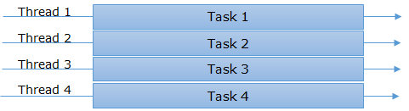
Synchronous Programming Model (II)
Synchronous Multi-Threaded Programming Model
In this environment, we used to have multiple threads which can take up these tasks and start working on that.
It means we have a pool of threads (new threads can also be created based on the requirement and available resources) and bunch of tasks.

Slide 7
Asynchronous Programming Model (I)
In contrary to synchronous programming model, here a thread once start executing a task it can hold it in mid, save the current state and start executing another task.
Asynchronous Single Threaded Programming Model
A single thread is responsible to complete all the tasks and tasks are interleaved to each other.

Slide 8
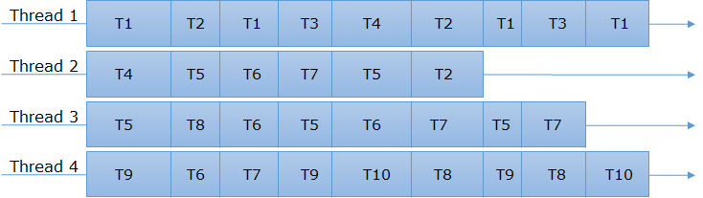
Asynchronous Programming Model (II)
Asynchronous Multi-Threaded Programming Model
If our system is capable of having multiple threads then all the threads can work in asynchronous model as well

Slide 9
Concurrency
Concurrency means processing multiple requests at a time.
Synchronous Multi-Threaded Programming Model
Asynchronous Single Threaded Programming Model
Asynchronous Multi-Threaded Programming Model

Slide 10
JavaScript and Multithreading
JavaScript is a language.
It is not JavaScript supporting multithreading or not.
It is about interpreters providing such functionality.
The environments in which JavaScript is running for example browsers and Node.js have some support for what can be called multithreading.
https://developer.mozilla.org/en-US/docs/Web/API/Worker
https://nodejs.org/api/worker_threads.html

Slide 11


Slide 12

Why Concurrency?
Faster processing.
Non-blocking calls.

Slide 13
setTimeout
What are the outputs?
function checkForUpdates(){
console.log("Check for updates.");
}
function checkForNetworkStatus(){
console.log("Check for network status.");
}
// Take the call to checkForUpdates out of the normal flow
// and the engine will execute the function whenever it fits, delay 3 seconds before the execution.
setTimeout(checkForUpdates, 3000);
// Take the call to checkForNetworkStatus out of the normal flow
// and the engine will execute the function whenever it fits, as soon as possible.
setTimeout(checkForNetworkStatus, 0);
console.log("1");
console.log("2");
console.log("3");

Slide 14
Callbacks [1]
A callback is a function that you write and then pass to some other function.
That other function then invokes (“calls back”) your function when some condition is met or some (asynchronous) event occurs.
The invocation of the callback function you provide notifies you of the condition or event, and sometimes, the invocation will include function arguments that provide additional details.

Slide 15
Example Callback
const sum = n =>
{
let total = 0;
for (let i = 1; i <= n; i++) {
total += i;
}
return total;
}
function startTask(number, callback) {
const total = sum(number);
callback(total);
}
startTask(1, (total) => {
console.log("sum(1) =", total);
}
);
startTask(3, (total) => {
console.log("sum(3) =", total);
}
);

Slide 16
Asynchronous Callback
The callback function is supplied as an argument to a higher-order function that invokes ("calls back") the callback function to perform an operation.
The synchronous callback is executed during the execution of the higher-order function that uses the callback.
The asynchronous callback is executed after the execution of the higher-order function.
function runHighOrderFunction(callback) {
console.log('High Order Function starts.'); setTimeout(callback, 2000); // run callback after 2 seconds.
console.log('High Order Function completed.');
} runHighOrderFunction(function later() {
console.log('later() called');
}
);

Slide 17
Asynchronous Execution
const sum = n =>
{
let total = 0;
for (let i = 1; i <= n; i++) {
total += i;
} return total;
}
function startTask(number, callback, delays) {
setTimeout( () => {
const total = sum(number);
callback(total);
}, delays);
}
startTask(1, (total) => {
console.log("sum(1) =", total);
}, 500
); startTask(3, (total) => {
console.log("sum(3) =", total);
}, 100
);

Slide 19
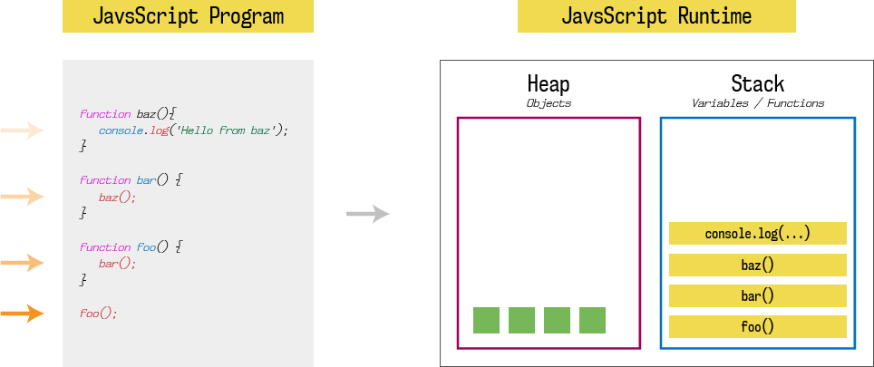
JavaScript Runtime

Slide 20
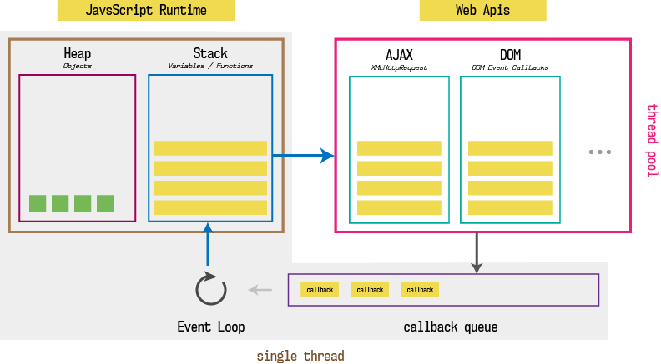
Callback Queue

Slide 21
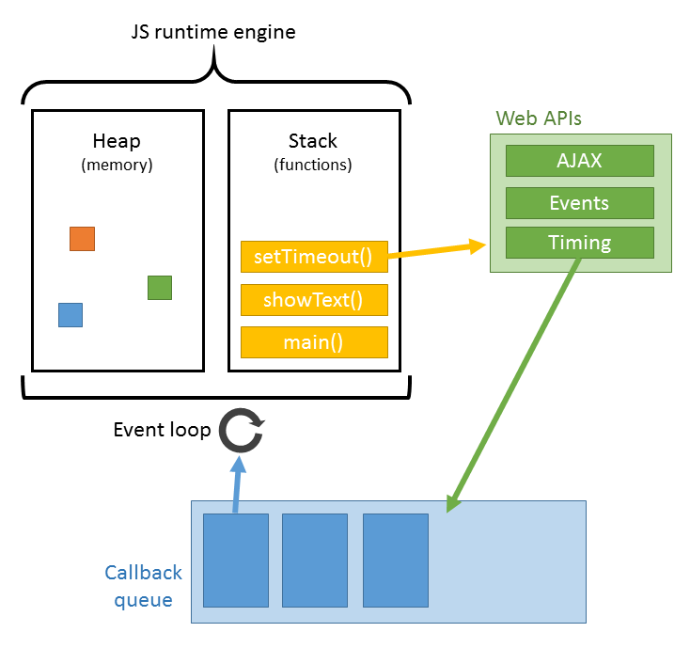
Event Loop

Slide 23
(Client-Side) Browser Events
Client-side JavaScript programs are almost universally event driven. The web browser generates an event when the user presses a key on the keyboard, moves the mouse, clicks a mouse button, or touches a touchscreen device.
Event-driven JavaScript programs register callback functions for specified types of events in specified contexts, and the web browser invokes those functions whenever the specified events occur.
These callback functions are called event handlers or event listeners, and they are registered with addEventListener():
// Ask the web browser to return an object representing the HTML
// <button> element that matches this CSS selector
let okay = document.querySelector('#confirmUpdateDialog button.okay');
// Now register a callback function to be invoked when the user
// clicks on that button.
okay.addEventListener('click', applyUpdate);

Slide 24
(Client-Side) Network Events
Another common source of asynchrony in JavaScript programming is network requests.
function versionCallback(error, version) { console.log(error); }
function getCurrentVersionNumber(versionCallback) { // Note callback argument // Make a scripted HTTP request to a backend version API
let request = new XMLHttpRequest();
request.open("GET", "http://www.example.com/api/version"); request.send();
// Register a callback that will be invoked when the response arrives
request.onload = function() {
if (request.status === 200) { // If HTTP status is good, get version number and call callback.
let currentVersion = parseFloat(request.responseText);
versionCallback(null, currentVersion); }
else { // Otherwise report an error to the callback
versionCallback(response.statusText, null);
}
};
// Register another callback that will be invoked for network errors request.onerror = request.ontimeout = function(e) { versionCallback(e.type, null); };
}
getCurrentVersionNumber(versionCallback);

Slide 25
Server-Side Callbacks and Events
The Node.js server-side JavaScript environment is deeply asynchronous and defines many APIs that use callbacks and events.
const fs = require("fs"); // The "fs" module has filesystem-related APIs
let options = { // An object to hold options for our program
// default options would go here
};
// Read a configuration file, then call the callback function
fs.readFile("config.json", "utf-8", (err, text) => {
if (err) {
// If there was an error, display a warning, but continue
console.warn("Could not read config file:", err);
} else {
// Otherwise, parse the file contents and assign to the options object
Object.assign(options, JSON.parse(text));
}
// In either case, we can now start running the program
startProgram(options);
});

Slide 27
Callback Problem
One real problem with callback based asynchronous programming is that it is common to end up with callbacks inside callbacks inside callbacks, with lines of code so highly indented that it is difficult to read.

Slide 28
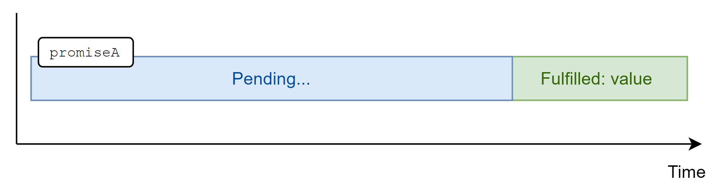
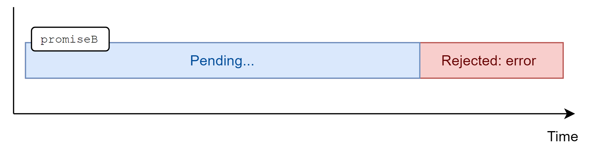
Promises
A Promise is an object that represents the result of an asynchronous computation.
That result may or may not be ready yet, and the Promise API is intentionally vague about this: there is no way to synchronously get the value of a Promise; you can only ask the Promise to call a callback function when the value is ready.

Slide 29
1. Create Sum Function
const sum = n =>
{
let total = 0;
for (let i = 1; i <= n; i++) {
total += i;
}
return total;
}

Slide 30
2. Create and Return a Promise
function startTask(number) {
return new Promise((resolve, reject) => {
// async operation
setTimeout( () => {
try {
const total = sum(number);
resolve(total); // async operation successful
} catch (e) {
reject(e); // async operation error
}
}, 0);
}
);
}

Slide 31
3. Use the Promise
startTask(1).then( (respone) => {
console.log("sum(1) =", respone);
},
(error) => {
console.log(error);
}
);
startTask(3).then( (respone) => {
console.log("sum(3) =", respone);
},
(error) => {
console.log(error);
}
);

Slide 32
Fetching a URL Example
getJSON() starts an asynchronous HTTP request for the URL you specify and then, while that request is pending, it returns a Promise object.
The Promise object defines a then() instance method.
Instead of passing our callback function directly to getJSON(), we instead pass it to the then() method.
// Suppose you have a function like this to display a user profile
function displayUserProfile(profile) { /* implementation omitted */ }
// Here's how you might use that function with a Promise.
// Notice how this line of code reads almost like an English sentence:
getJSON("/api/user/profile").then(displayUserProfile);

Slide 33
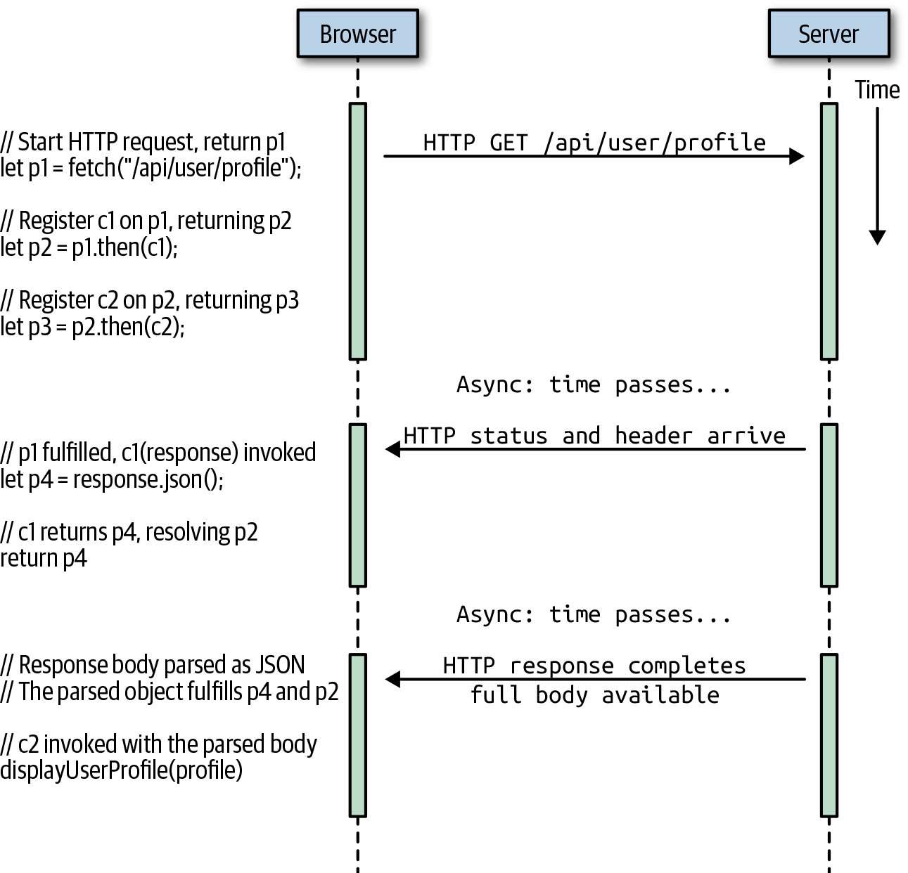
Fetching a URL Example

Slide 34
The await Keyword
The await keyword takes a Promise and turns it back into a return value or a thrown exception.
Given a Promise object p, the expression await p waits until p settles.
If p fulfills, then the value of await p is the fulfillment value of p.
On the other hand, if p is rejected, then the await p expression throws the rejection value of p.
let response = await fetch("/api/user/profile");
let profile = await response.json();

Slide 35
async Functions
Because any code that uses await is asynchronous, there is one critical rule: you can only use the await keyword within functions that have been declared with the async keyword.
Declaring a function async means that the return value of the function will be a Promise even if no Promise-related code appears in the body of the function.
If an async function appears to return normally, then the Promise object that is the real return value of the function will resolve to that apparent return value.
And if an async function appears to throw an exception, then the Promise object that it returns will be rejected with that exception.
async function getHighScore() {
let response = await fetch("/api/user/profile");
let profile = await response.json();
return profile.highScore;
}

Slide 36
The for/await Loop
Node 12 makes its readable streams asynchronously iterable.
This means you can read successive chunks of data from a stream with a for/await loop like this one:
Roughly speaking, the asynchronous iterator produces a Promise and the for/await loop waits for that Promise to fulfill, assigns the fulfillment value to the loop variable, and runs the body of the loop.
const fs = require("fs");
async function parseFile(filename) {
let stream = fs.createReadStream(filename, { encoding: "utf-8"});
for await (let chunk of stream) {
parseChunk(chunk); // Assume parseChunk() is defined elsewhere
}
}

Slide 37
Asynchronous Iterators
An iterable object is one that can be used with a for/of loop.
It defines a method with the symbolic name Symbol.iterator. This method returns an iterator object.
The iterator object has a next() method, which can be called repeatedly to obtain the values of the iterable object.
The next() method of the iterator object returns iteration result objects. The iteration result object has a value property and/or a done property.
Asynchronous iterators are quite similar to regular iterators, but there are two important differences.
First, an asynchronously iterable object implements a method with the symbolic name Symbol.asyncIterator instead of Symbol.iterator.
Second, the next() method of an asynchronous iterator returns a Promise that resolves to an iterator result object instead of returning an iterator result object directly.

Slide 39
Nodejs Worker Threads
https://www.simplilearn.com/tutorials/nodejs-tutorial/nodejs-worker-threads

Slide 40
Web Workers
https://www.freecodecamp.org/news/how-webworkers-work-in-javascript-with-example/

Slide 41

Further Reading
https://developer.mozilla.org/en-US/docs/Web/API/Web_Workers_API/Using_web_workers
https://nodejs.org/api/worker_threads.html

Slide 42

Thank You & See You Again

